Slide 1
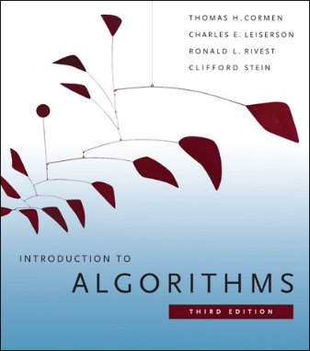
Data Structures - Review
[CLRS] – Chap 10, Chap 11, Chap 6.5
[CLRS] = Thomas H. Cormen, Charles E. Leiserson, Ronald L. Rivest and Clifford Stein, Introduction to Algorithms, 3rd Ed, MIT Press, 2009.

Slide 2
Data Structures
Program = Algorithm + Data Structures
The design of an algorithm must be based on the understanding of data structure techniques and costs
Abstract Data Type:
  Defined by the list of supported operations
  Hides the implementation details of these operations

Slide 3
Dynamic Sets
Collections of data manipulated by algorithms; can grow, shrink or change over time
Operations on dynamic sets: S=a dynamic set
  Search (S, k)
  Insert (S, x)
  Delete (S, x)
  Minimum (S)
  Maximum(S)
  Successor(S, x)
  Predecessor(S, x)

Slide 4
Implementing Dynamic Sets
The best way to implement a dynamic set is determined by the subset of operations that must be supported !
There are particular types of Dynamic Sets, determined by certain frequent occuring subsets of operations: The Fundamental Data Structures
  Each data structure addresses comes with a purpose: it addresses a particular usage context that requires a particular subset of operations

Slide 5
Fundamental Data Structures
Stacks:
  Insert (Push), Delete (Pop)
  Implemented by Lists; O(1), O(1)
Queues:
  Insert (Enqueue), Delete (Dequeue)
  Implemented by Lists; O(1), O(1)
Priority Queues: see for review [CLRS chap 6.5]
  Insert, Maximum, ExtractMax, IncreaseKey
  Implemented by Heaps; O(log n), O(1), O(log n), O(log n)
Dictionaries:
  Insert, Search, Delete
  Implemented by Hashtables: see for review [CLRS chap 11]
  Generalizes the simple arrays, allows direct addressing of arbitrary positions in O(1)
  Hashing with chaining; Hashing with open addressing

Slide 6
Libraries Implementing
Fundamental Data Structures
There are standard libraries implementing the fundamental data structures for most languages
It is recommended to use these implementations instead of redoing your own !
BUT: in order to use them correct and appropriate, don’t forget anything that you learned about fundamental data structures !
Java: Collections
  https://docs.oracle.com/javase/tutorial/collections/TOC.html
C++: STL Containers
  http://www.cplusplus.com/reference/stl/
C#: System.Collections
  https://msdn.microsoft.com/en-US/library/system.collections%28v=vs.110%29.aspx
Python: non-primitive types list, set, dict
  https://docs.python.org/3/library/stdtypes.html

Slide 7
Fundamental Data Structures - Java
Class java.util.Stack
Interface java.util.Queue
  General purpose (not for concurrent use) queue implementation: class java.util.LinkedList
Interface java.util.Deque
  General purpose implementations: classes java.util.ArrayDeque, java.util.LinkedList
Class java.util.PriorityQueue
  Implements an unbounded priority queue based on a Heap.
Class java.util.HashSet
Class java.util.HashMap

